Slide 1

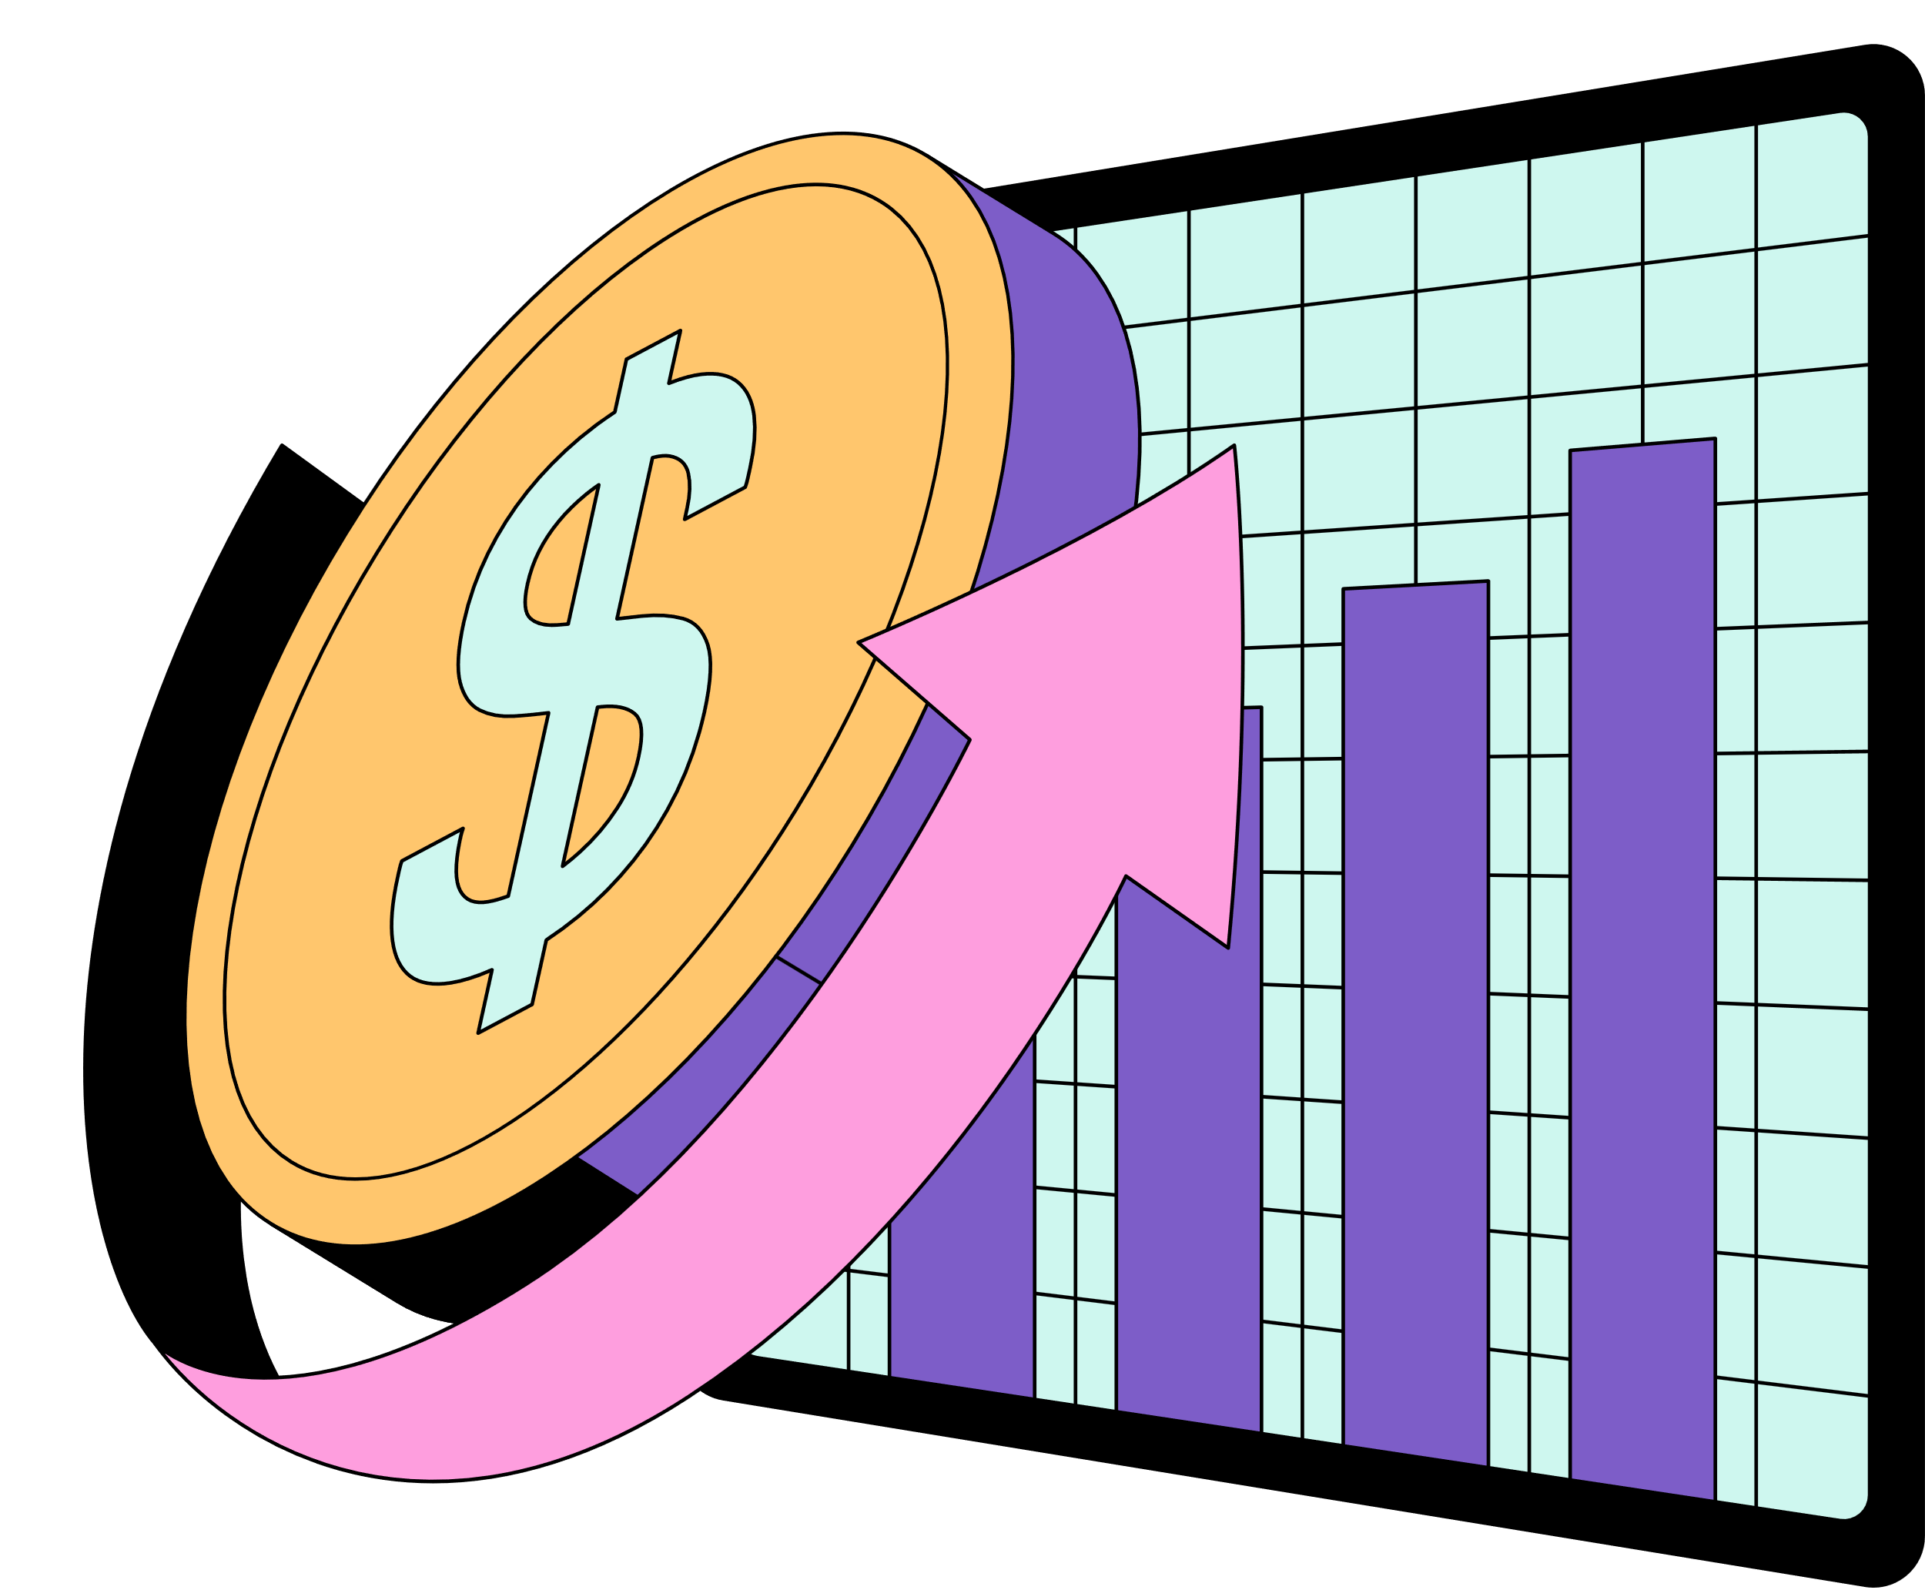
Understanding The
New York Stock Exchange
Presented by Satendra Singh Katewa

Slide 2


What Is The New York Stock Exchange (NYSE)
The NYSE is the largest equities exchange in the world.
Founded in 1792, headquartered in New York City.
Lists over 2,400 companies across major sectors.
Provides liquidity, transparency, and global market access.
Hosts many of the world’s most valuable companies.
Notes:
2

Slide 3

Project Overview
This project analyzes historical NYSE data to extract actionable insights.
Combines SQL, Python, and Power BI for a comprehensive analysis workflow.
Focus areas:
Price trends & volatility.
Sector analysis.
Valuation metrics.
Predictive modeling.

Slide 4

Data Sources
Fundamentals Dataset
Earnings Per Share (EPS)
Net Income
Total Debt
Market Capitalization
EBITDA
Prices Dataset
Daily stock prices (open, high, low, close, adjusted close, volume)
Period covered: January 4, 2010 – December 30, 2016
Securities Dataset
Ticker symbols and security descriptions
Sectors Dataset
Sector and sub-industry classifications for each company
Source:
Data Source: NY Stock

Slide 5

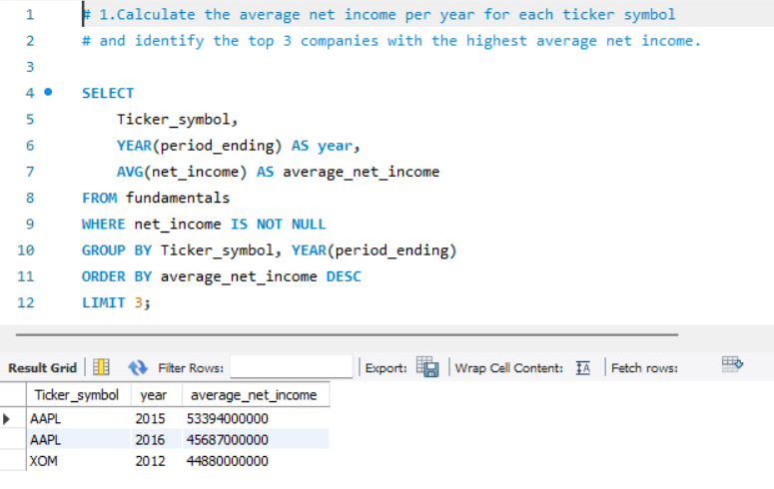
Part 1: SQL Analysis

Slide 6
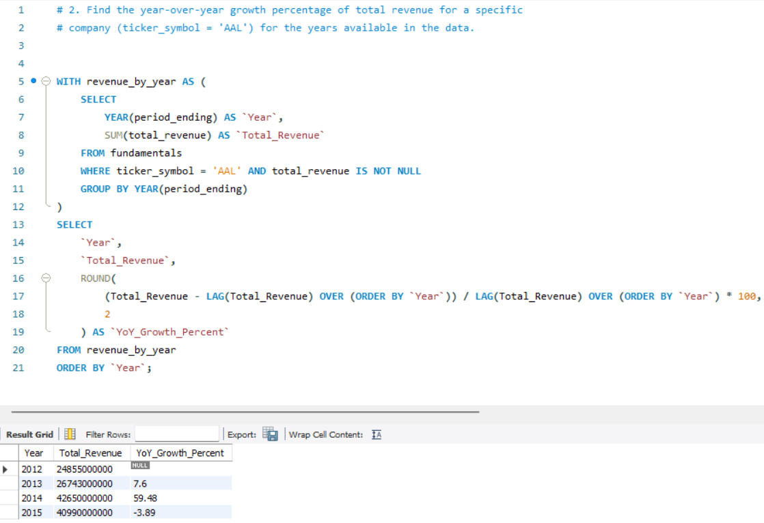


Slide 7
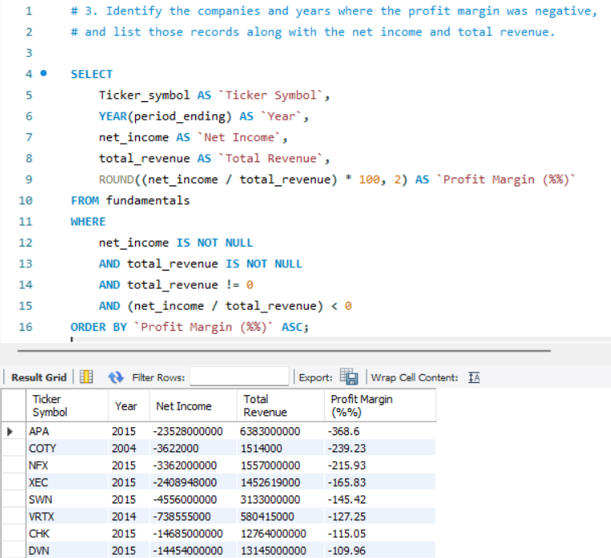



Slide 8
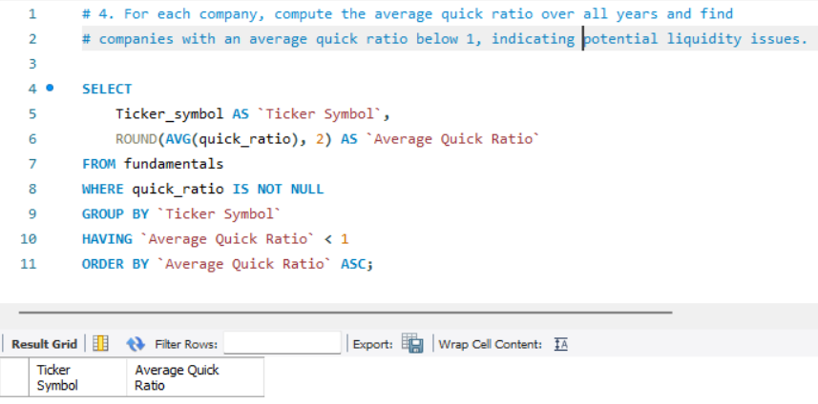
Insight 1 – Liquidity Risk Identification: This query identifies companies whose average quick ratio is below 1, signaling potential liquidity issues—they may not be able to cover short-term liabilities with their most liquid assets.
Insight 2 – Prioritized Action List: By sorting results ascending, you get a ranked list of the riskiest companies first, enabling finance teams to prioritize further investigation and mitigation strategies for those with the weakest liquidity positions.

Slide 9
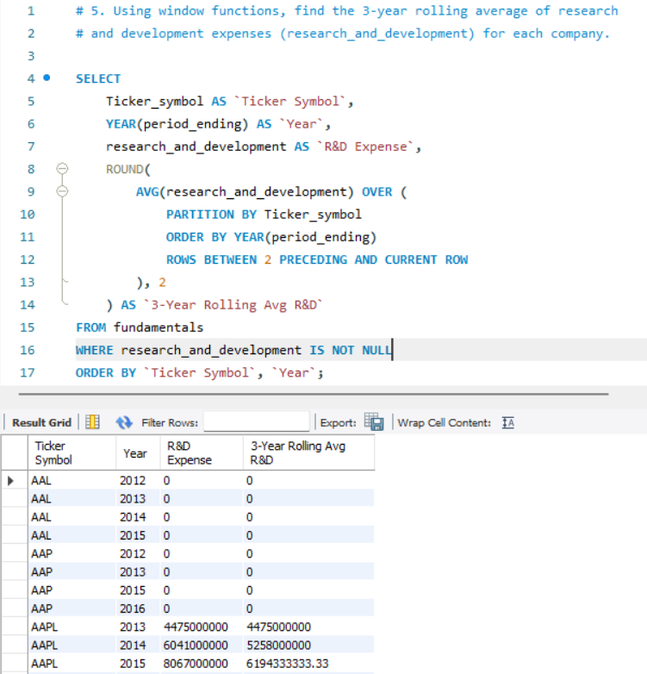

Slide 10
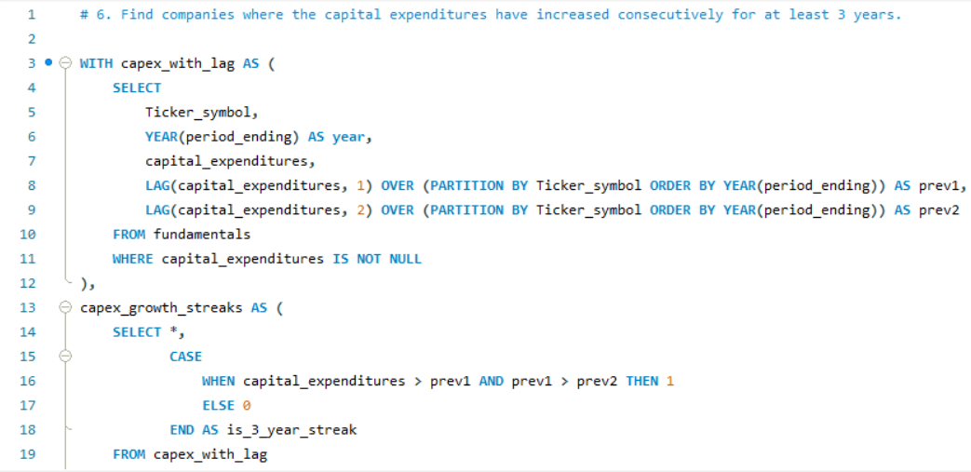

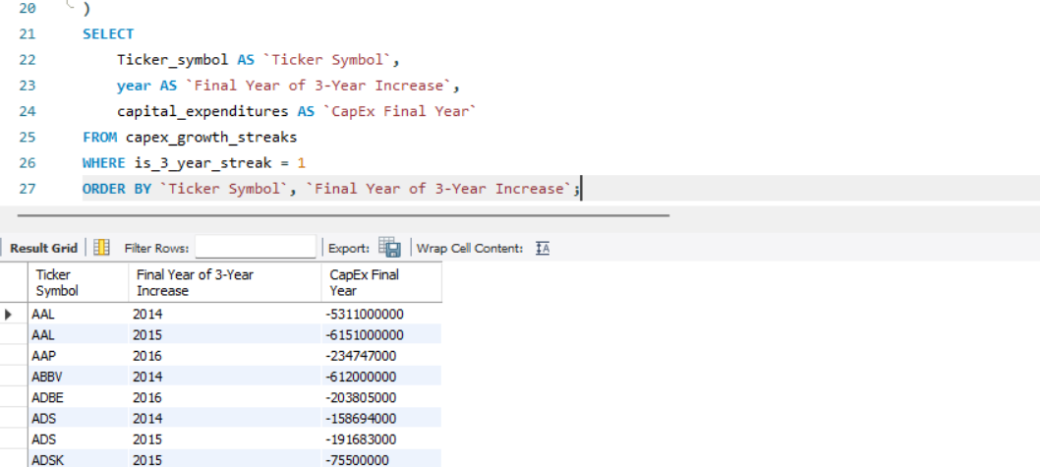

Slide 11
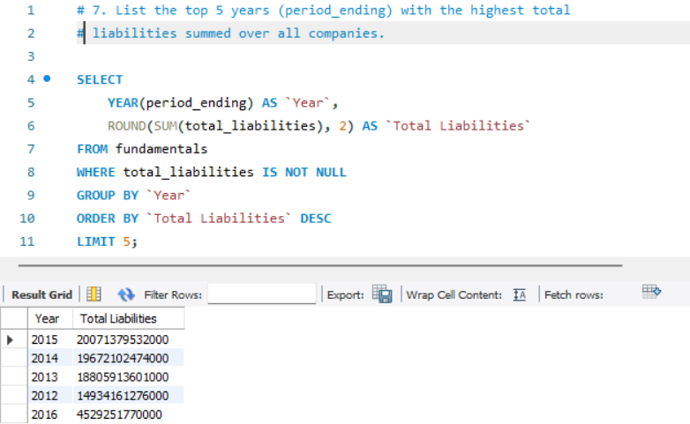
Insight 1 – Peak Liability Years: The query pinpoints the top 5 years when companies had the highest combined total liabilities, highlighting periods of increased leverage or expansion financing across the market.

Slide 12
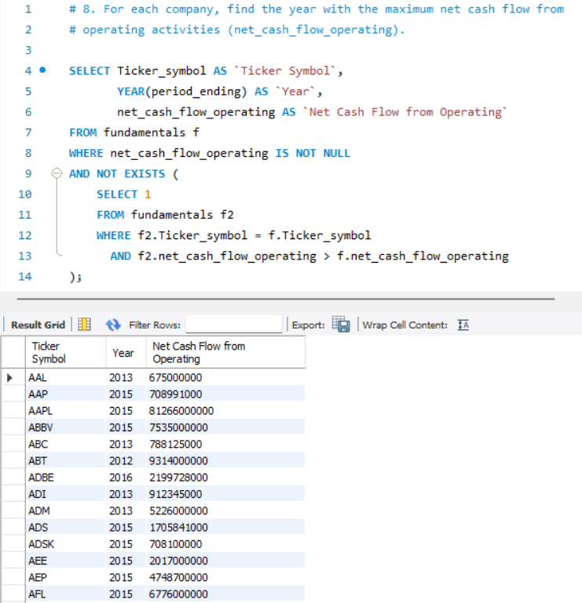

Slide 13
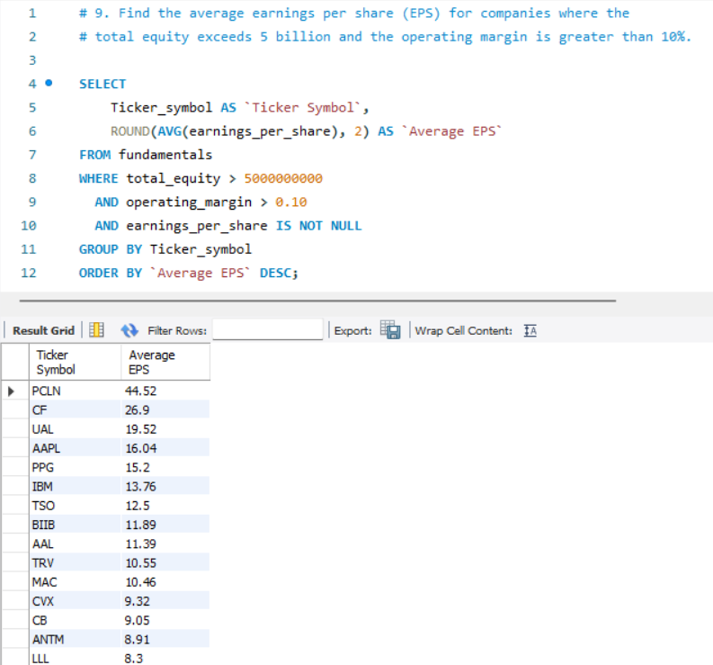

Slide 14
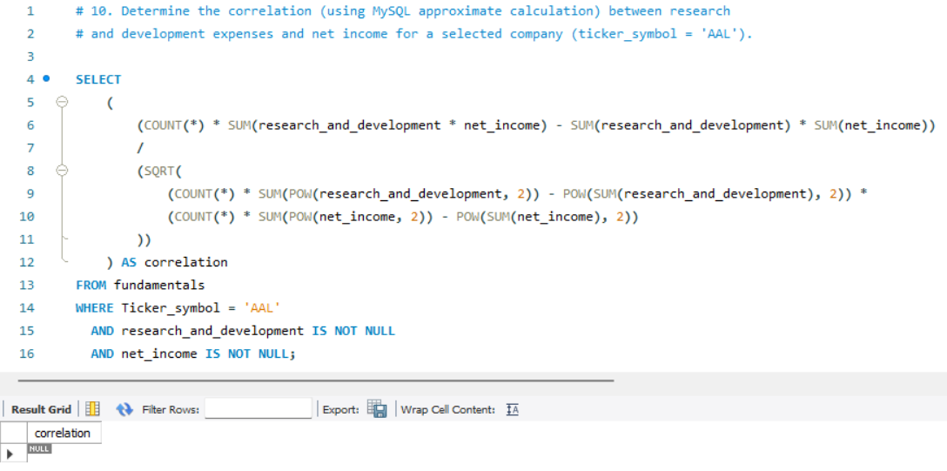
Insight 1 – Relationship Between R&D and Profitability: The correlation quantifies how research and development spending is related to net income for AAL, revealing whether higher innovation investments tend to drive profits or coincide with losses.
Insight 2 – Strategic Decision Support: Understanding this correlation helps assess the effectiveness of R&D strategy, guiding management decisions on whether to increase, maintain, or reallocate R&D budgets to optimize financial performance.

Slide 15
SQL Analysis Insights Summary
Most Profitable Companies: The top 3 companies consistently achieved the highest average net income over the years, demonstrating strong and stable profitability compared to their peers.
Revenue Growth Trends (AAL): AAL’s year-over-year revenue growth shows how effectively the company expands its business, revealing periods of acceleration and contraction that inform strategic planning.
Negative Profit Margins: Several companies reported negative profit margins in certain years—highlighting times when expenses exceeded revenues, which signals operational challenges and financial risk.
Liquidity Health: A subset of companies has an average quick ratio below 1, indicating they may struggle to cover short-term obligations without relying on inventory sales—a potential liquidity concern for investors.
R&D Investment Patterns: The 3-year rolling average of R&D expenses shows which companies consistently invest in innovation and product development, providing insight into long-term growth strategies.

Slide 16
More Insights of SQL Analysis
Capital Expenditure Trends: Some companies have demonstrated 3 consecutive years of increasing capital investments, reflecting expansion efforts or modernization of infrastructure.
Leverage Over Time: The top 5 years with the highest total liabilities point to periods when companies collectively took on significant debt, which could impact financial stability.
Operational Cash Flow Peaks: Identifying each company’s peak year of net cash flow from operating activities uncovers when core business operations were most financially productive.
High-Quality Earnings: Companies with large equity bases (>5 billion) and strong operating margins (>10%) maintained healthy average earnings per share, indicating robust and efficient profitability.
R&D-Profit Correlation (AAL): The correlation between R&D spending and net income for AAL reveals whether innovation investments align with profit generation—guiding resource allocation decisions.

Slide 17
Part 2: Power BI / Tableau Dashboard
The dashboards were designed to:
Summarize key performance indicators such as revenue, net income, profit margins, and liquidity.
Highlight trends and patterns across sectors, companies, and time periods.
Enable dynamic filtering by date ranges, sectors, and individual companies.
Compare valuation metrics, including P/E ratios and market capitalization distributions.
Identify high-risk and high-growth companies using custom measures and calculated fields.
Support data-driven decisions through clear visuals like bar charts, line graphs, pie charts, and KPI cards.
Power BI’s capabilities were leveraged to:
Clean and model data imported from SQL and CSV sources.
Create DAX measures for advanced calculations (e.g., YoY growth, rolling averages).
Design professional layouts with cohesive color themes and consistent formatting.
Publish interactive reports that can be shared and refreshed automatically.

Slide 18
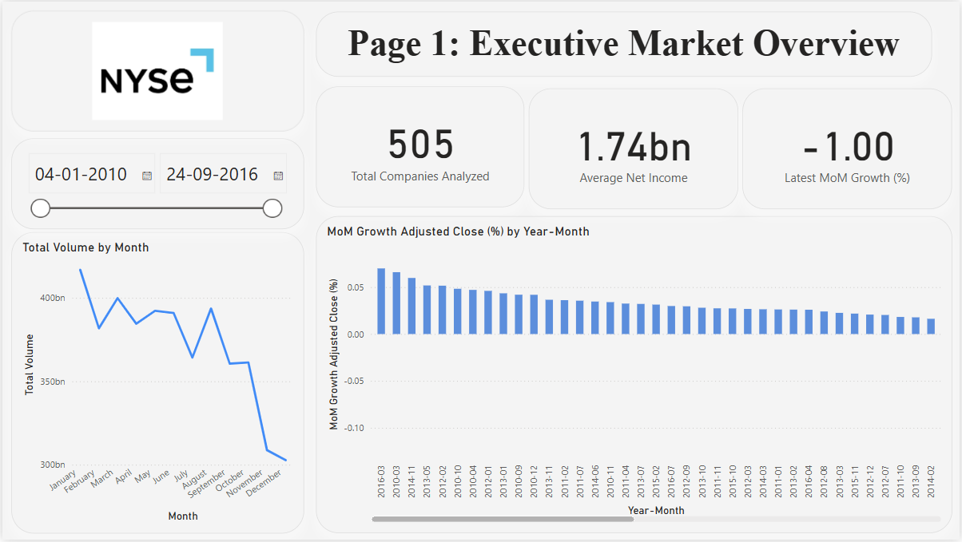

Slide 19

Executive Summary: Market Overview Dashboard Insights
Visual Highlights:
Date Range: 2010–2016 coverage, showing long-term market trends.
Companies Analyzed: 505 listed companies included in the dataset.
Key KPIs Displayed:
Average Net Income: $1.74 billion
Latest Month-on-Month (MoM) Growth: –1.00% decline
Trends and Anomalies:
Declining Volume: Total trading volume showed a consistent downtrend, especially noticeable after mid-2015.
MoM Growth Fluctuations: Early periods (2010–2011) recorded strong positive MoM growth (~5–6%), followed by a sustained decline over later years, turning negative in recent periods.
Seasonality: Volume peaks visible around March and August, suggesting cyclical trading patterns.
Opportunities:
Recovery Potential: The negative MoM growth and lower volumes could signal undervalued stocks and buying opportunities.
Targeted Analysis: Companies maintaining positive growth despite the overall downturn may offer strategic investment value.

Slide 20
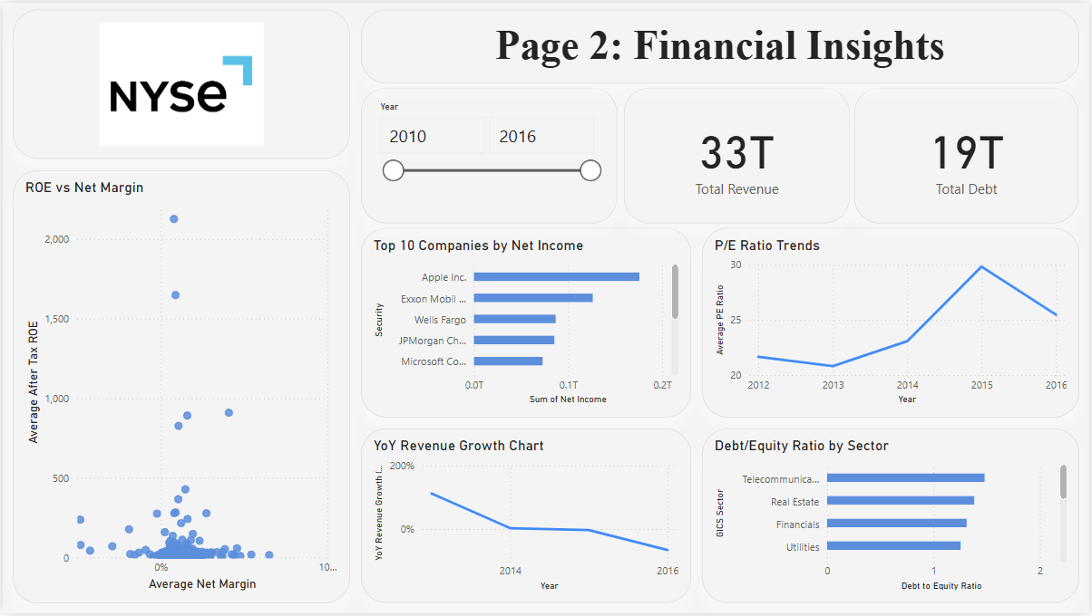

Slide 21

Financial Insights Overview: Key Highlights and Trends
Visual Highlights:
Dataset Coverage: 2010–2016 financials across all listed companies.
Aggregate Metrics:
Total Revenue: $33 trillion
Total Debt: $19 trillion
Top Earners: Apple Inc., Exxon Mobil, and Wells Fargo are the top 3 companies by net income.
Trends and Observations:
P/E Ratio Dynamics: After remaining stable from 2012–2014, the average Price-to-Earnings ratio spiked sharply in 2015 before declining in 2016, indicating valuation volatility.
Revenue Growth: Year-over-year revenue growth shows a clear downward trend, suggesting market saturation or slowing expansion.
Leverage Insights: The Telecommunications sector displays the highest debt-to-equity ratio among sectors analyzed, highlighting higher financial leverage risks.
Profitability Scatter: The ROE vs. Net Margin chart shows most companies clustered near low or negative net margins, while a few outliers achieve exceptionally high returns on equity.
Opportunities and Risks:
Monitoring Top Performers: Companies consistently leading in net income could be resilient investment candidates.
Sector Leverage Management: Industries with high debt-to-equity ratios may face increased vulnerability in downturns, requiring careful credit risk assessment.
Valuation Timing: Fluctuations in the P/E ratio suggest that timing of entry and exit could significantly impact returns.

Slide 22
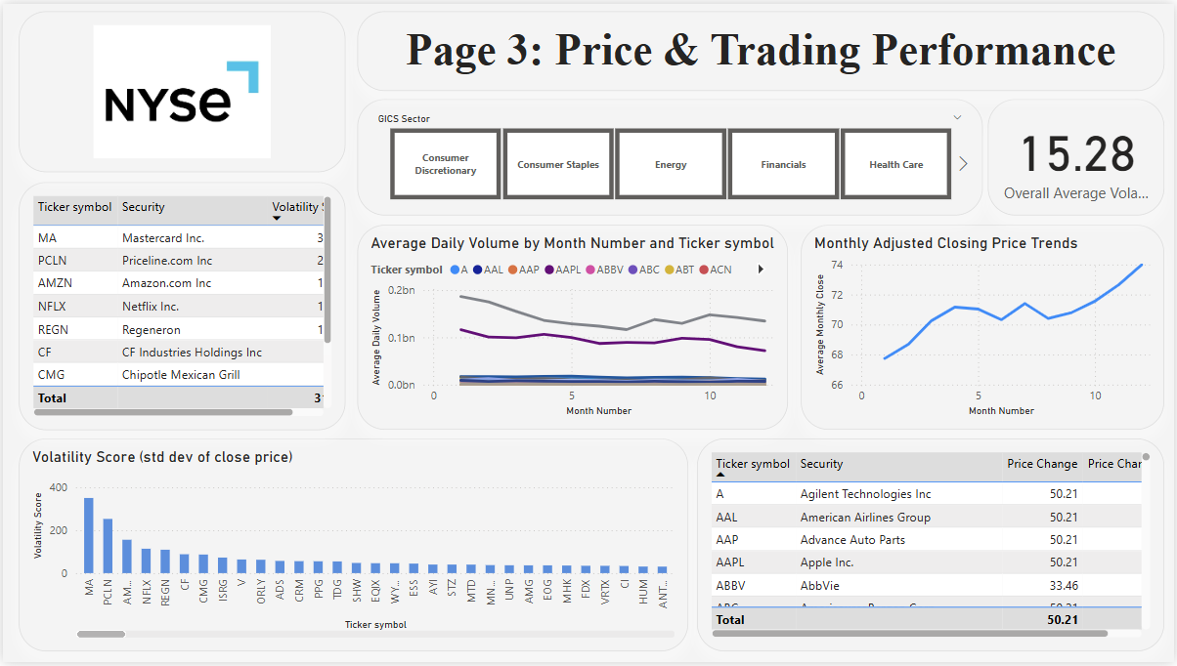

Slide 23

Price & Trading Performance Overview
Visual Highlights:
Coverage: Trading behavior across sectors including Consumer Discretionary, Financials, and Health Care.
Overall Average Volatility: 15.28 (standard deviation of close prices).
Leaders in Volatility: Mastercard, Priceline, and Amazon show the highest volatility scores.
Trends and Observations:
Volume Dynamics:
Average daily trading volumes declined steadily over the year for most tickers, potentially signaling reduced liquidity or investor interest.
Price Trends:
The Monthly Adjusted Closing Price chart reveals a consistent upward trajectory in average closing prices, suggesting a bullish trend across tracked securities.
Volatility Distribution:
A small group of stocks drives most of the volatility, with long tails of companies exhibiting stable price behavior.
Price Movements:
Top tickers including Apple and American Airlines show significant price changes, with leading performers recording gains over 50 points.
Opportunities and Risks:
Active Trading Opportunities: High-volatility stocks such as Mastercard and Priceline may offer short-term trading potential but carry higher risk.
Momentum Plays: Sustained upward closing price trends could present momentum trading or investment entry points.
Liquidity Considerations: Declining trading volumes might impact execution costs and require closer monitoring for institutional positions.

Slide 24
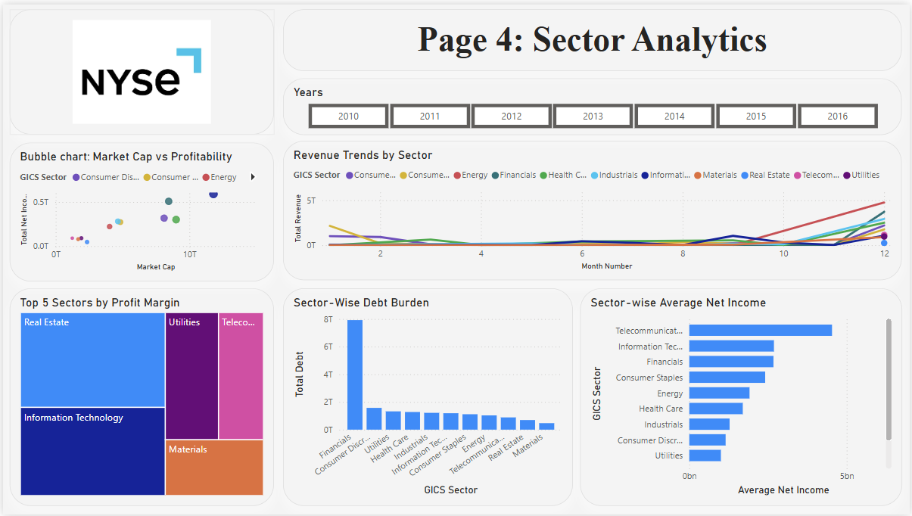

Slide 25

Sector Performance and Analytics Overview
Visual Highlights:
Market Capitalization vs. Profitability:
Large-cap sectors such as Consumer Discretionary and Information Technology also drive the highest net income, indicating strong scalability and operational leverage.
Revenue Trends:
Most sectors showed stable revenues throughout the year, with a notable rise in Energy and Consumer sectors toward the year-end.
Profit Margin Leaders:
Real Estate, Information Technology, and Utilities emerged as the top three sectors by profit margin.
Key Insights:
Sector-Wise Debt:
The Financials sector carries the heaviest debt burden by a wide margin (>7T), highlighting both systemic leverage and potential risk exposure.
Other sectors such as Consumer Discretionary and Utilities also hold significant debt loads, but at much lower scales.
Average Net Income:
Telecommunications leads in net income generation, followed closely by Information Technology and Financials.
Profitability vs. Scale:
Bubble chart visualization underscores how sectors with larger market caps tend to achieve higher absolute profitability, reinforcing their dominant position in the market.
Opportunities and Risks:
Growth Sectors: Rising revenue in Energy and Consumer sectors suggests near-term expansion opportunities.
Leverage Concerns: Elevated debt in Financials could magnify risks during economic downturns.
Defensive Plays: Sectors like Utilities and Real Estate deliver attractive profit margins, potentially providing stability during volatility.

Slide 26
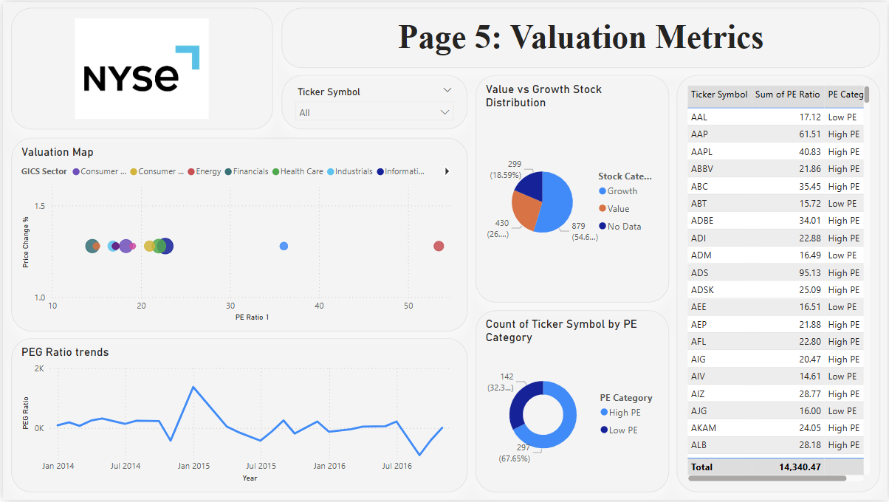

Slide 27
Valuation Metrics Overview
Visual Highlights:
Valuation Map:
Most sectors cluster within a PE ratio range of ~10–30, showing modest price change percentages.
A few outliers in Energy and Information Technology display significantly higher PE ratios (>40).
Value vs. Growth Stock Distribution:
Growth stocks represent the majority (54.6%), with value stocks accounting for ~26% of the dataset.
PEG Ratio Trends:
PEG ratios have remained largely stable over time, with occasional spikes indicating periods of increased growth expectations or valuation premiums.
Key Insights:
PE Ratio Breakdown:
High PE stocks are predominant (67.65%), suggesting market optimism and potentially stretched valuations in several sectors.
Low PE stocks (32.3%) may offer opportunities for value-oriented investors seeking lower multiples.
Top Stocks by PE Ratio:
The highest PE ratio observed exceeds 90, underscoring the premium investors are placing on certain companies’ growth prospects.
Sector Positioning:
Information Technology and Consumer sectors tend to exhibit higher PE ratios relative to Industrials and Financials, reflecting strong market confidence in growth trajectories.
Opportunities and Considerations:
Growth Bias:
The prevalence of high PE and growth stocks could expose portfolios to valuation risk if earnings growth slows.
Valuation Anchors:
Value stocks and low PE sectors may serve as defensive holdings or rebalancing opportunities.
Monitoring PEG Trends:
Tracking PEG ratio fluctuations remains essential for identifying shifts in growth expectations relative to earnings.

Slide 28
Part 3: Python
Jupyter Notebook Overview
Purpose: Cleaned, analyzed, and forecasted time-series trading data to extract actionable trends and validate hypotheses.
Key Components
Data Preprocessing:
Handling missing values & outliers
Feature engineering for time-series attributes
Exploratory Data Analysis (EDA):
Volatility, volume, and price trend visualization
Correlation and seasonality assessment
Forecasting Models:
Time-series decomposition
ARIMA/Prophet models for predictive insights
Outputs:
Trend & seasonality charts
Forecasted price and volume datasets (CSV)
Notebook Link: Part_3_Python
Impact
This notebook enables:
Clear identification of historical patterns & anomalies
Accurate future projections to inform strategy
Transparent, reproducible analysis pipeline

Slide 29
Project Deliverables Overview
SQL Queries & Visualizations
Structured SQL queries to answer key business questions
Visual charts illustrating query outputs
Clear insights and explanations included in the PPT
Interactive Dashboard
Built in Power BI or Tableau
Multi-page navigation with slicers and filters
Dynamic visuals to explore sector and stock performance
Screenshots embedded in the final report
Python Analysis & Forecasting
Time-series data cleaning and preparation
Exploratory Data Analysis (EDA)
Forecasting models (e.g., ARIMA, Prophet)
Trend and seasonality charts
Exported forecast data in CSV format

Slide 30
Insights & Recommendations
Insights Report
Executive Summary
Key findings, trends, and market signals
Visual Highlights
Top sectors, stock volatility, valuation metrics
Trends & Anomalies
Notable shifts in volume, pricing, and sector performance
Actionable Recommendations
Long-Term Sector Health
Focus on sectors with consistent revenue growth and lower debt burden
Valuation Signals
Identify stocks with high PE ratios that may be overvalued
Spot undervalued opportunities among low PE and strong fundamentals
Investment Priorities
Prioritize investments in sectors showing stable price trends and profitability
Leverage forecasting to time entries into growth stocks

Slide 31
Conclusion
This project combines robust data analysis, forecasting, and interactive visualization to deliver actionable insights for strategic investment decisions.
By leveraging SQL queries, Python modeling, and Power BI/Tableau dashboards, we have:
Uncovered sector-level trends in profitability, debt, and growth
Identified high- and low-volatility stocks with significant valuation signals
Forecasted price and volume trends to support data-driven investment timing
The insights and recommendations empower stakeholders to:
Focus on sectors demonstrating long-term financial health
Detect overvalued or undervalued stocks for rebalancing portfolios
Align investment strategies with market dynamics and fundamentals
Together, these deliverables provide a comprehensive foundation for informed decision-making and sustained growth in the equity markets.

Slide 32
More Information
EMAIL:
satendarsinghkatewa123@gmail.com
LINKEDIN:
Satendra_Singh_Katewa
GITHUB:
Satendra_Singh_Katewa
SQL QUERIES:
Part_1_SQL_Analysis
PYTHON JUPYTER NOTEBOOK:
Part_3_Python

Slide 33
Thank
You

